Slide 1
KindKrate
Supporting students without the Stress

Slide 2
Parents want to support their children.
Over 50% of college students experience burnout.
17.6% are out of state or international.

Slide 3
We're not just solving this problem—we've lived it.
We’re five college students who’ve lived the late-night cram sessions and the stress.
We built KindKrate because we know the power of a thoughtful gesture—and how hard it can be for families to send one.
Between us, we’ve built campus organizations, led peer mental health efforts, and shipped real products.

Slide 4
Most parents call, text, or send money.
But for some students, this can add more stress than it alleviates. And other gift options are too impersonal.

Slide 5
What if, instead...
Parents could send a thoughtful and personalized care package to their children when they need it most, without added stress

Slide 6
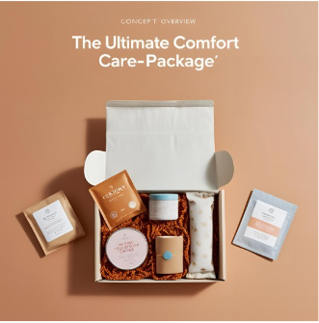
That’s us.
Curated exactly to what your student wants and needs.

Slide 7
We understand students
We know college stress firsthand and know exactly what the students and the parents want.
We’ve built products, launched student initiatives, and learned how to listen closely to what our peers want.
These care-packages are the best of both worlds keeping both the students and the parents happy.

Slide 8
Most care package companies are generic and one-size-fits-all.
KindKrate lets parents personalize boxes based on their student’s mood, dietary needs, hobbies, and academic calendar.
We use real student feedback to update and evolve our curated kits.
We offer on-campus delivery, meaning faster turnaround during stressful times like midterms and finals.

Slide 9
Why NOW?
Mental health awareness: More students and families are looking for proactive ways to reduce stress.
Personalization: Gen Z demands curated, not cookie-cutter.
Rise of “convenience-as-care”: From meal kits to digital therapy, families are investing in tools that show love from afar.

Slide 10
And ONE YEAR from now?..
We’ll have expanded to 10 additional colleges in Minnesota,
Added to our online offerings,
And expanded our marketing efforts

Slide 11
And what we're currently working on…
Machine learning solution to learn the best gifts for students based on preferences, time of year, and stress levels
Currently in Beta
Full rollout in August

Slide 12
What were asking for…
We are asking for $100,000 in exchange for 7% equity of our company.

Slide 13
With this investment…
Some milestones we will be able to achieve
Full launch and market all over the University of Minnesota reaching all freshman students and their parents
Reach a gross income of $90,000
Speed of production of our machine learning solution

Slide 14
Interested? Let’s talk.
team@kindkrate.com

